Slide 1


Slide 2
Agenda
What is OQU and how it useful for Qazaqstan in real life?
How EP project started?
What challenges did I face?
Middle of project
Conclusion of EP project
Quick summary

Slide 3

The mission of OQU Platform is to provide high quality application process to universities located on Kazakhstan.
Kazakh Information technology platforms( EGOV) had a really messy issues during COVID 19 in terms of application, OQU is web which provides information about Universities: rank, history, best students, facilities etc. (Githinji, 2020) Also, convenient process of applying is main feature of OQU platform

Slide 4
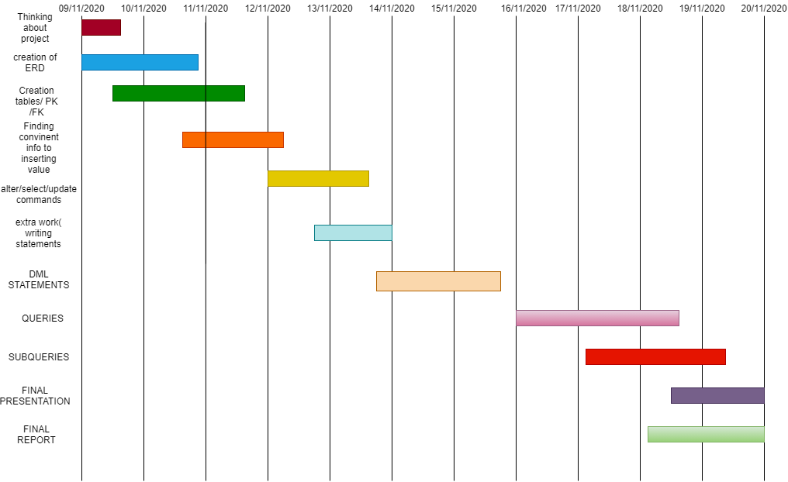
GANTT CHART

Slide 5
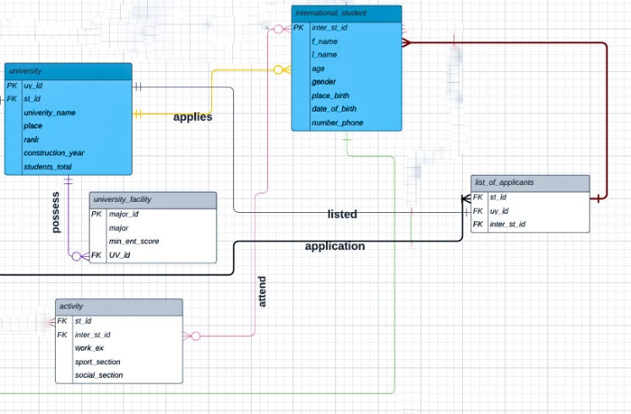
I started with creation of my ERD, because it is one of the main basic-fundamental project. Every time with new challenge I just look up my ERD and continue work.
One of main challenges that I faced was creation of ERD and finding sustainable information.

Slide 6
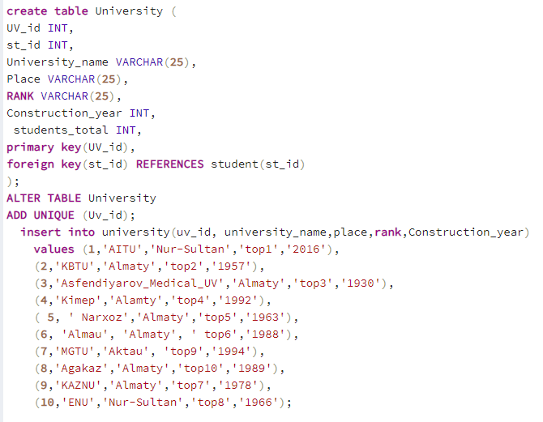
SQL
All information are about university(Guides, 2020),However, list of ranking was made by me
FK is to save actions that may destroy relations or connections between tables

Slide 7
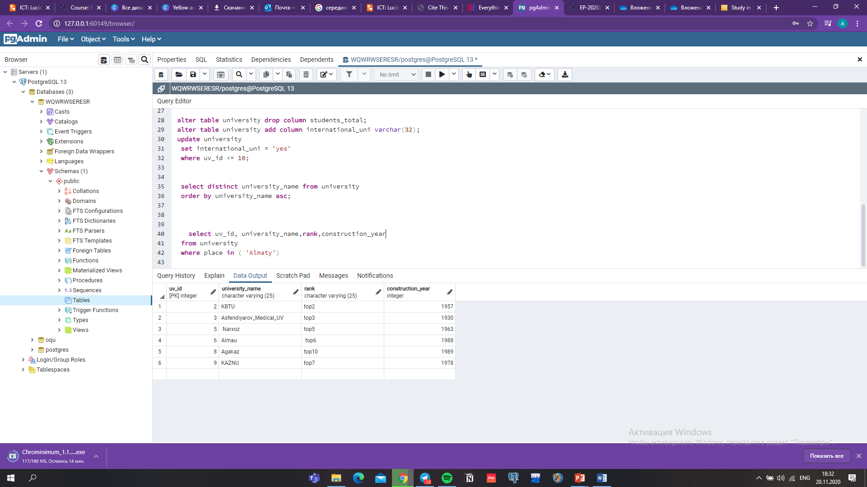
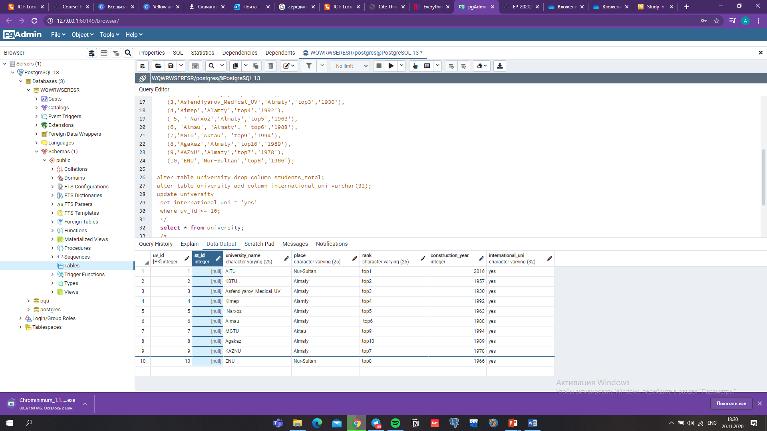
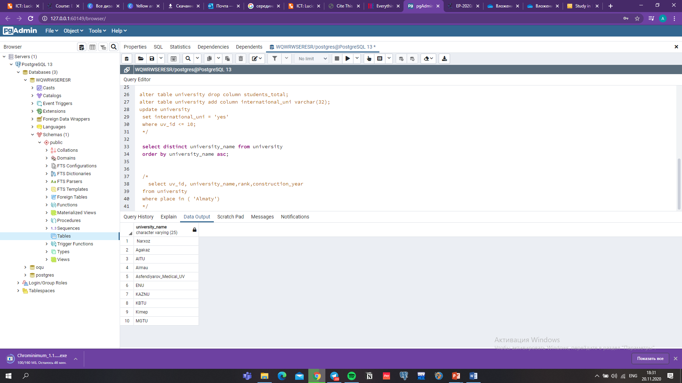
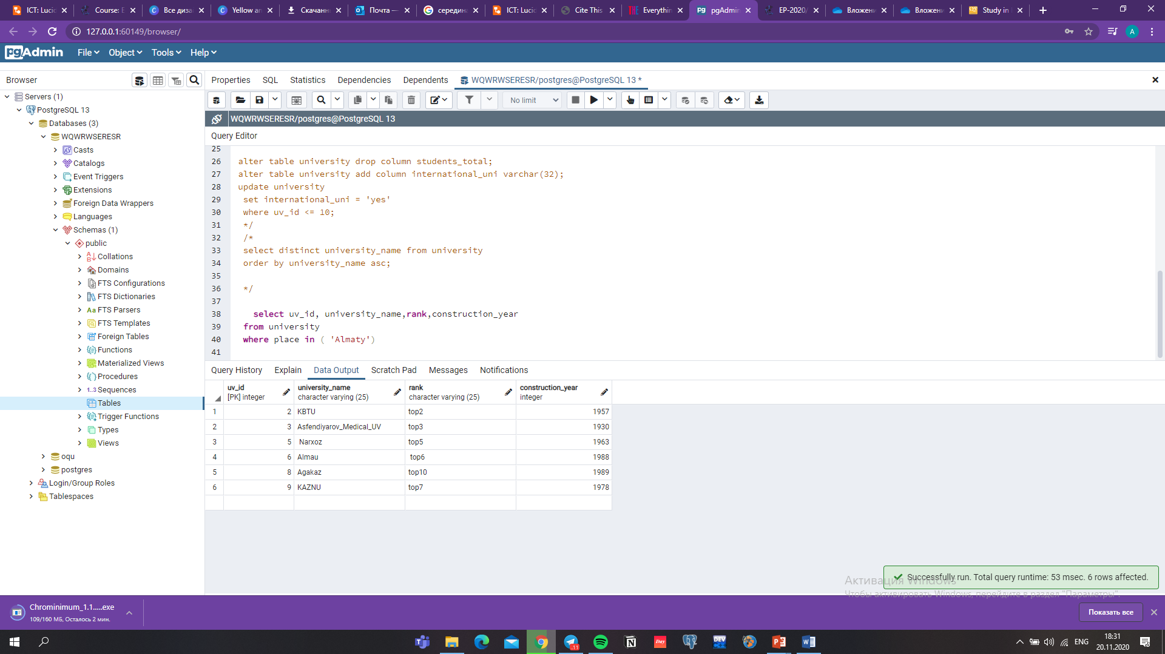

Slide 8
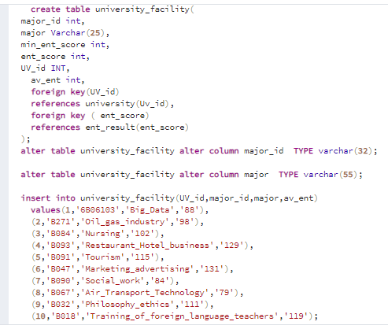
PROJECT PROCESS
This table includes all information about university_facility
All information cited from(портал, 2020)

Slide 9
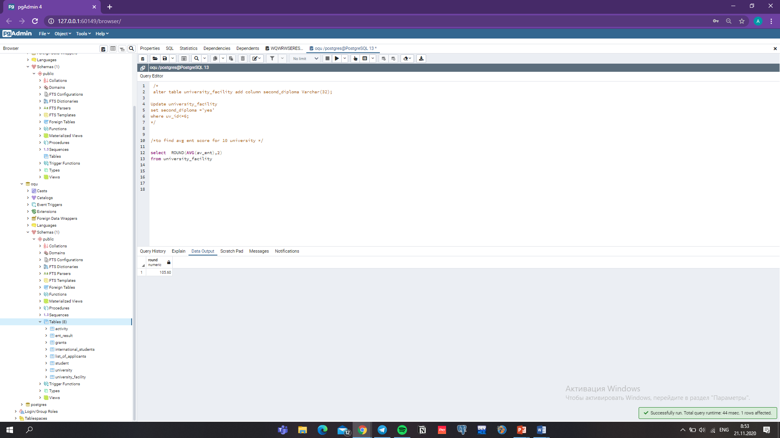
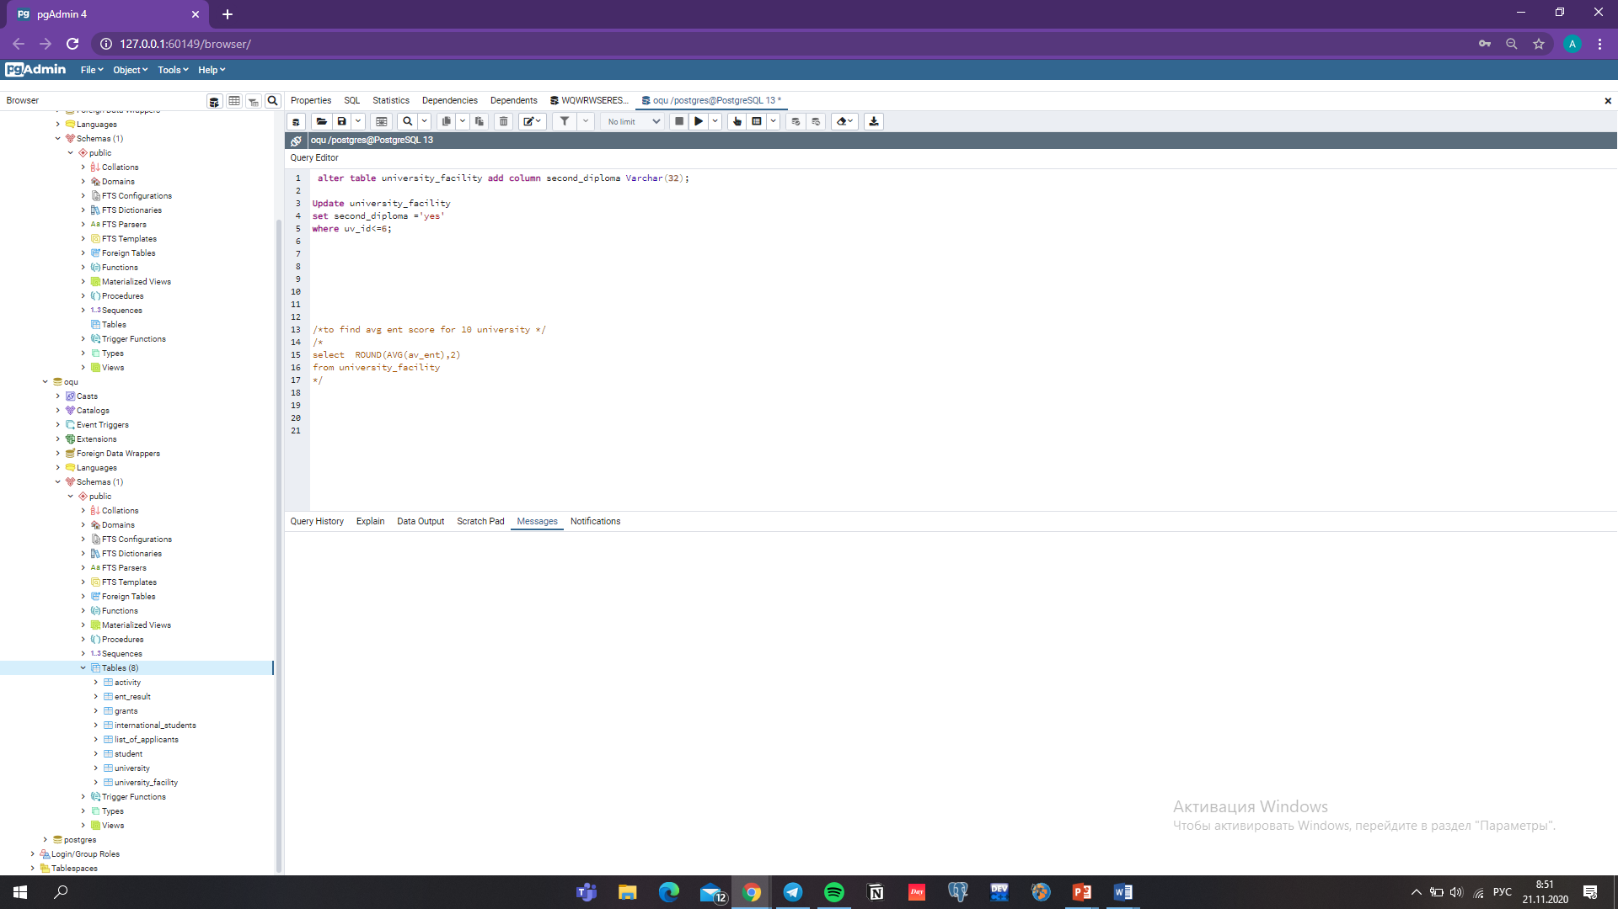
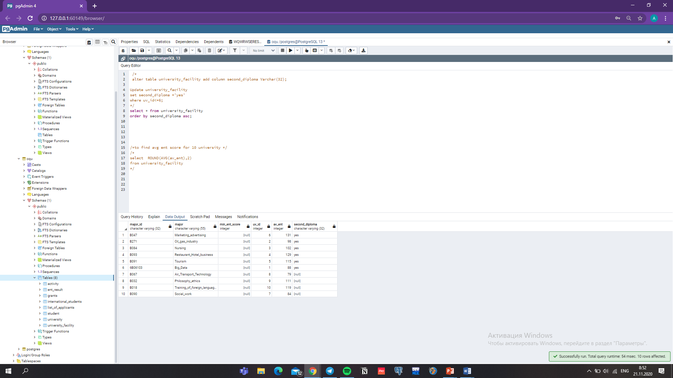
The UPDATE operator is used to change and work flexile with existing table entries.
The AVG() function returns the average value of specific column

Slide 10
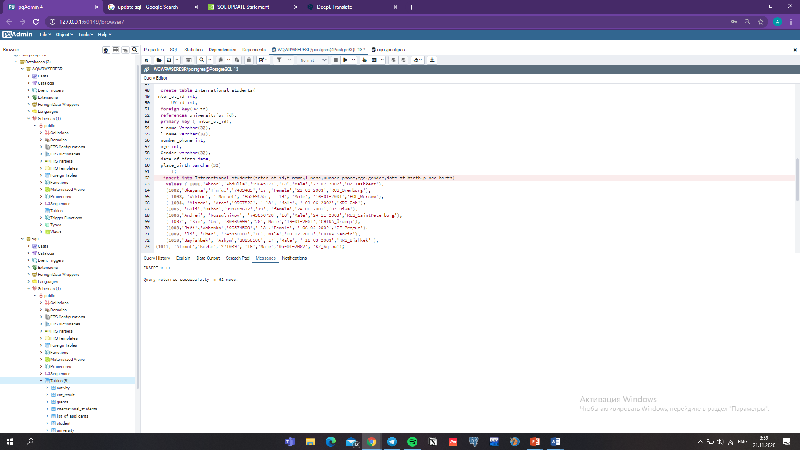
All included information was created by me.

Slide 11
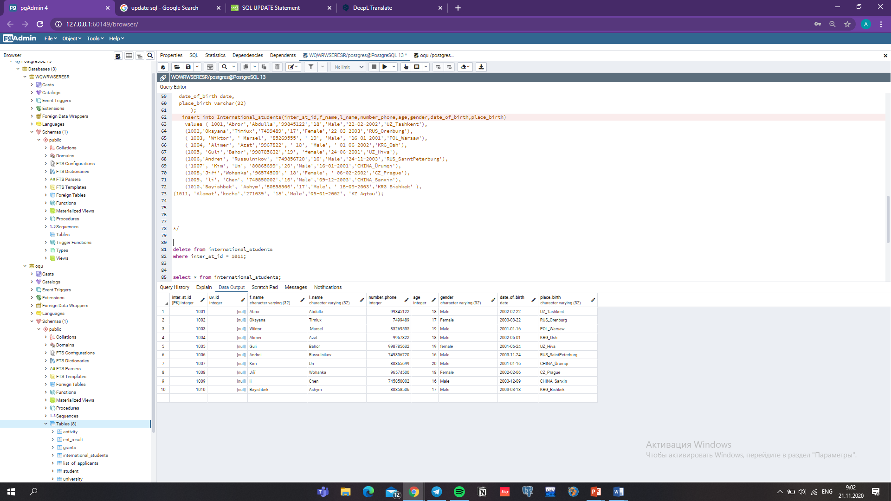
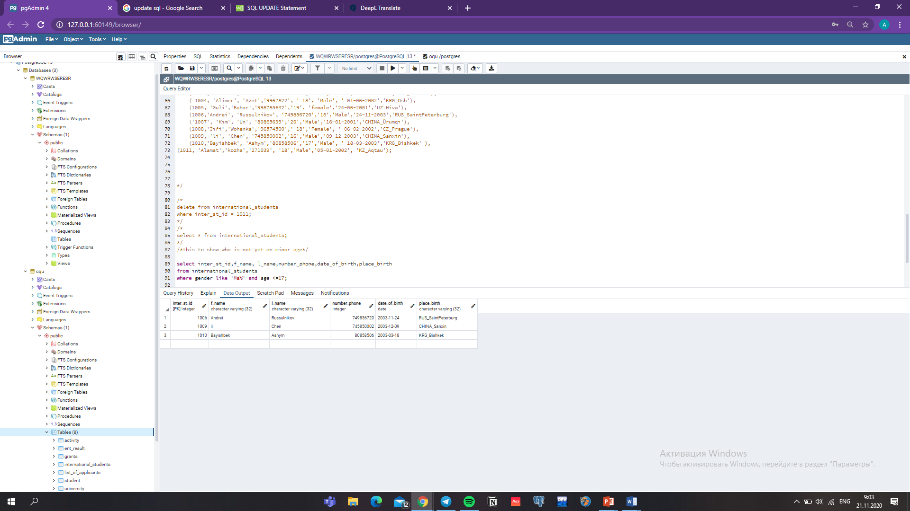
One of main figures of database is to work with missing values

Slide 12
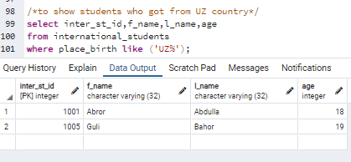
Main advantage of this database is to work properly, also to find convenient information
Finds any values that start with “UZ"

Slide 13
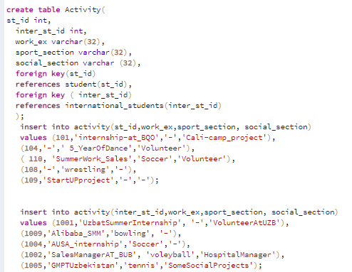
This table is willing store information about students activities out of school and academic purpose

Slide 14
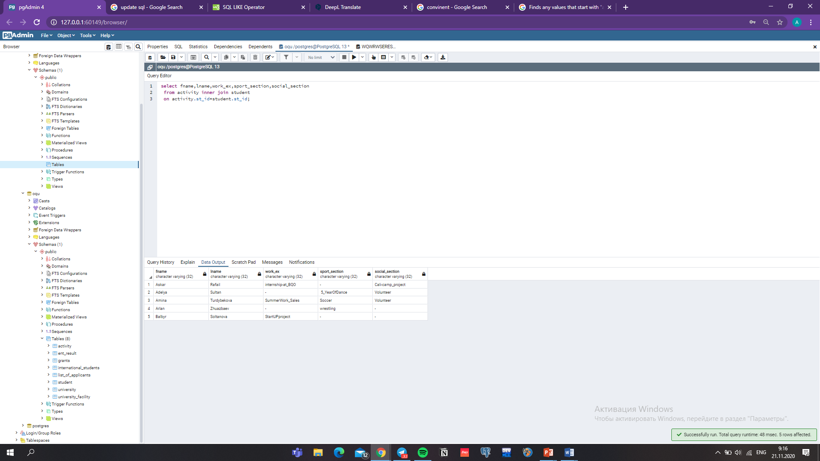
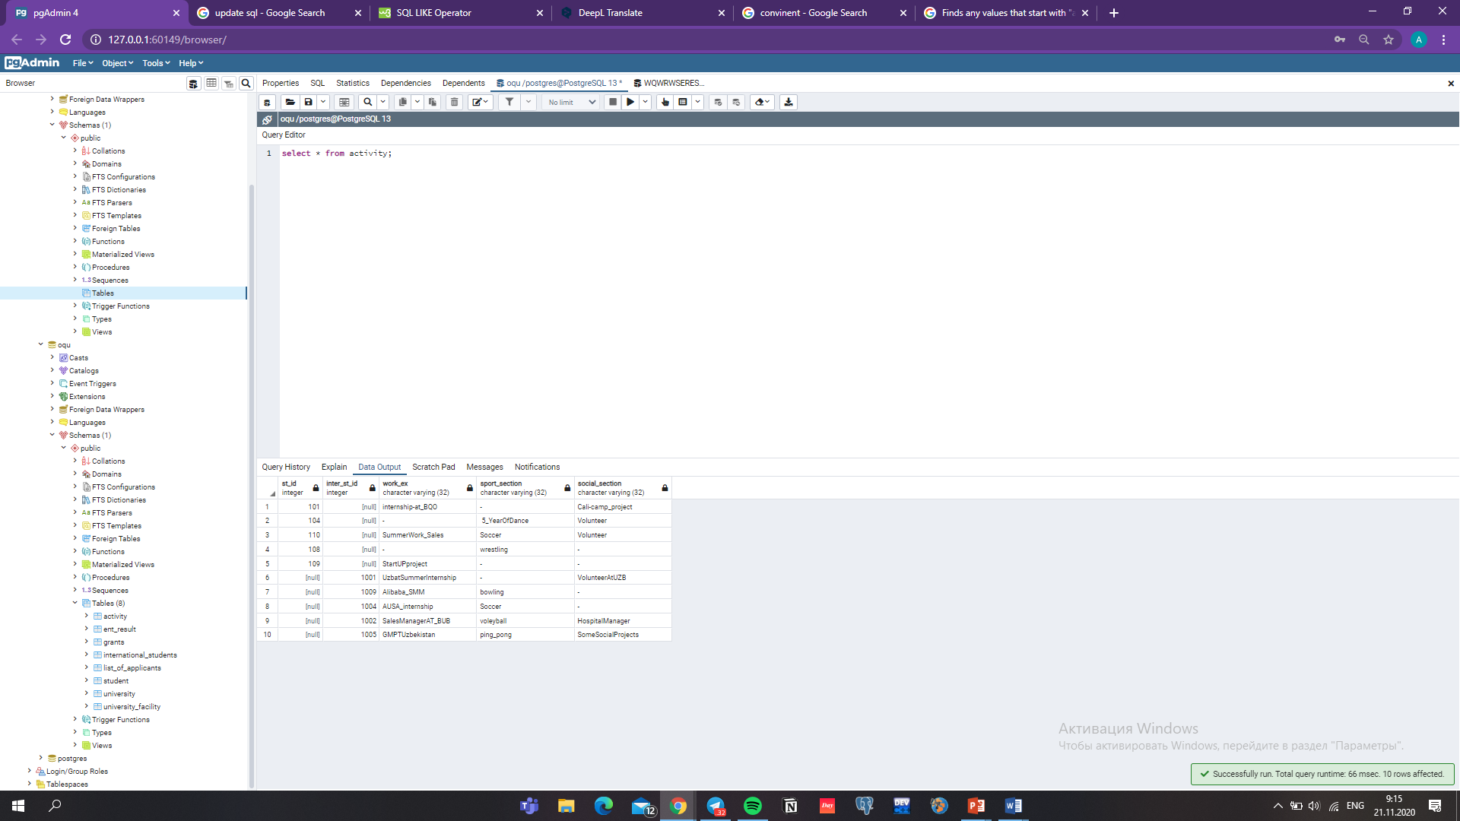
update activity
set sport_section ='ping_pong'
where inter_st_id = 1005;
The INNER JOIN keyword selects records that have matching-same values in both tables that I’ve pointed

Slide 15
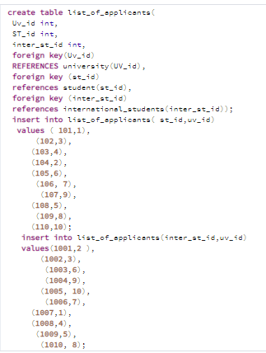
The mission this table is to appear students that got accepted to which university

Slide 16
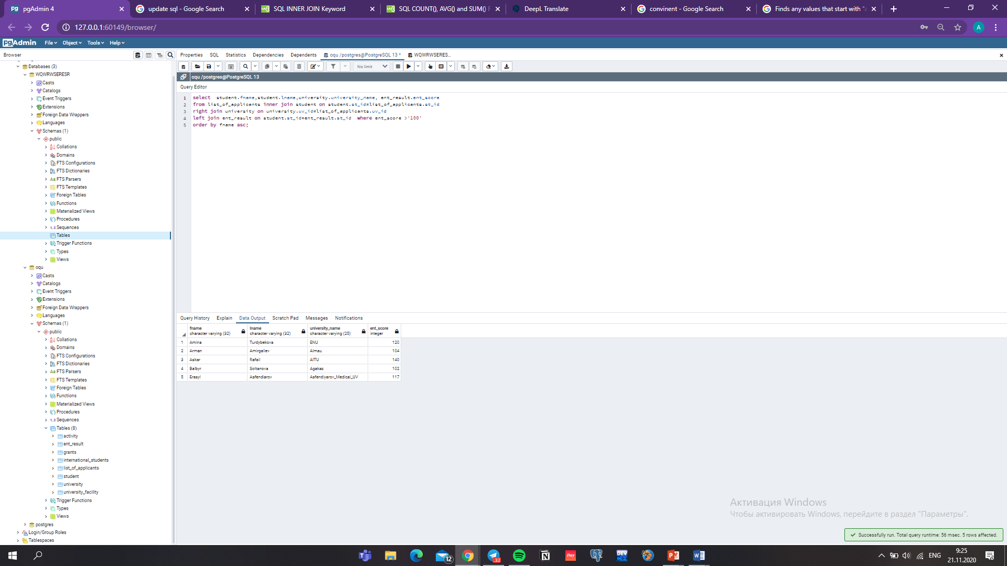
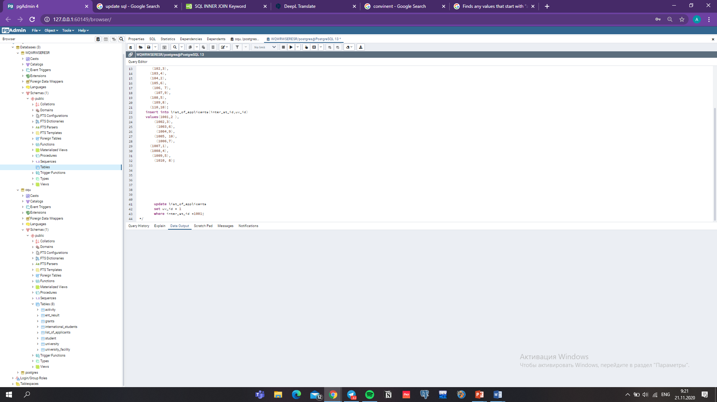
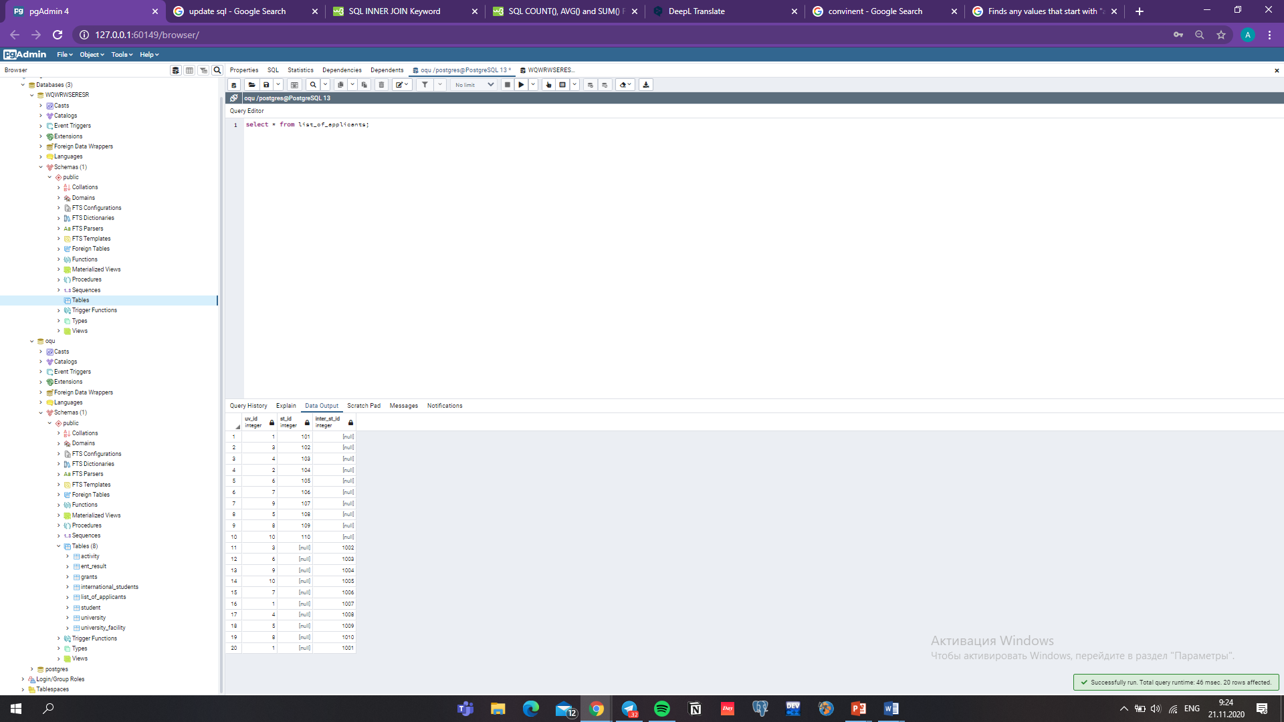

Slide 17
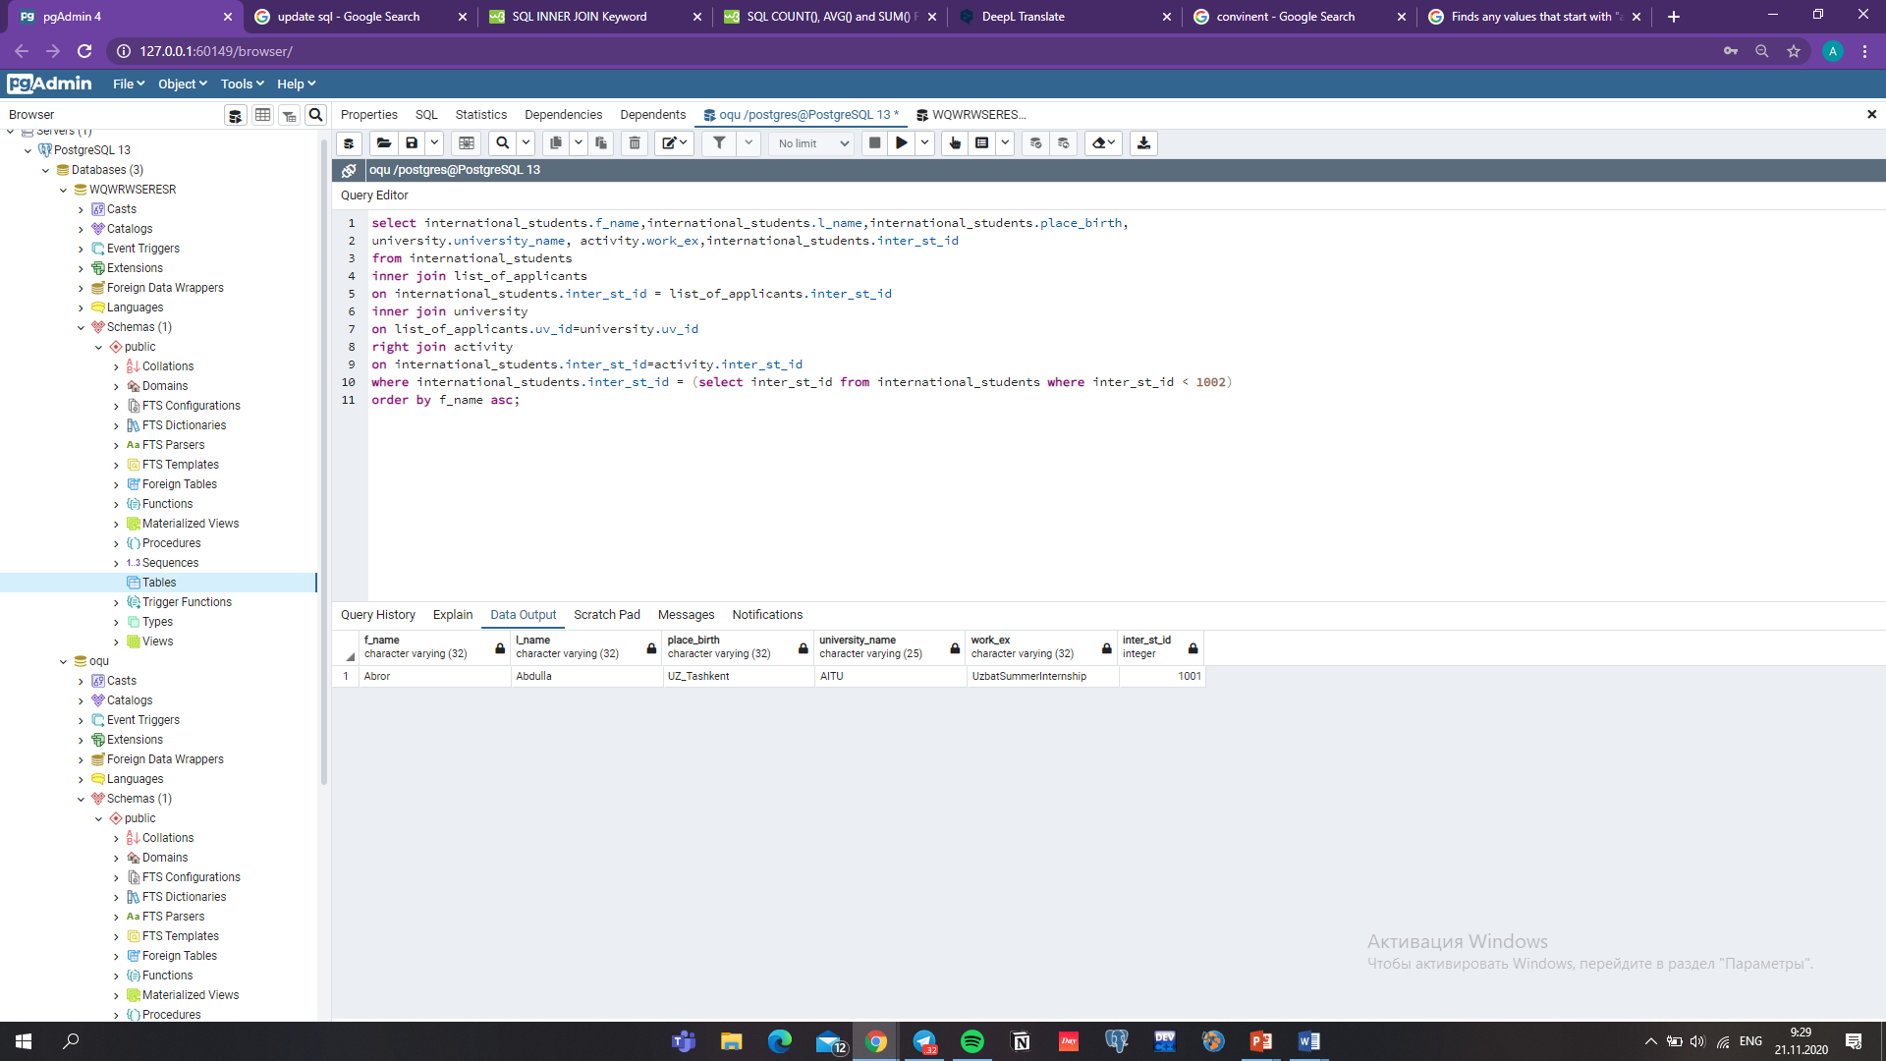
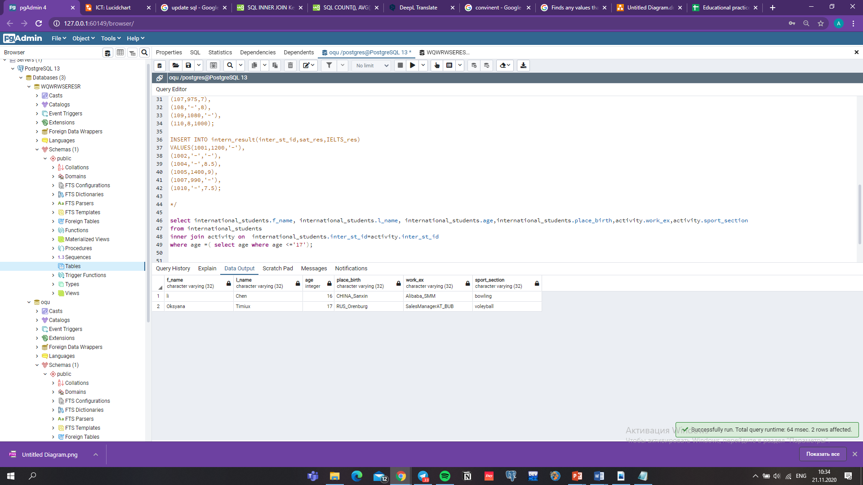
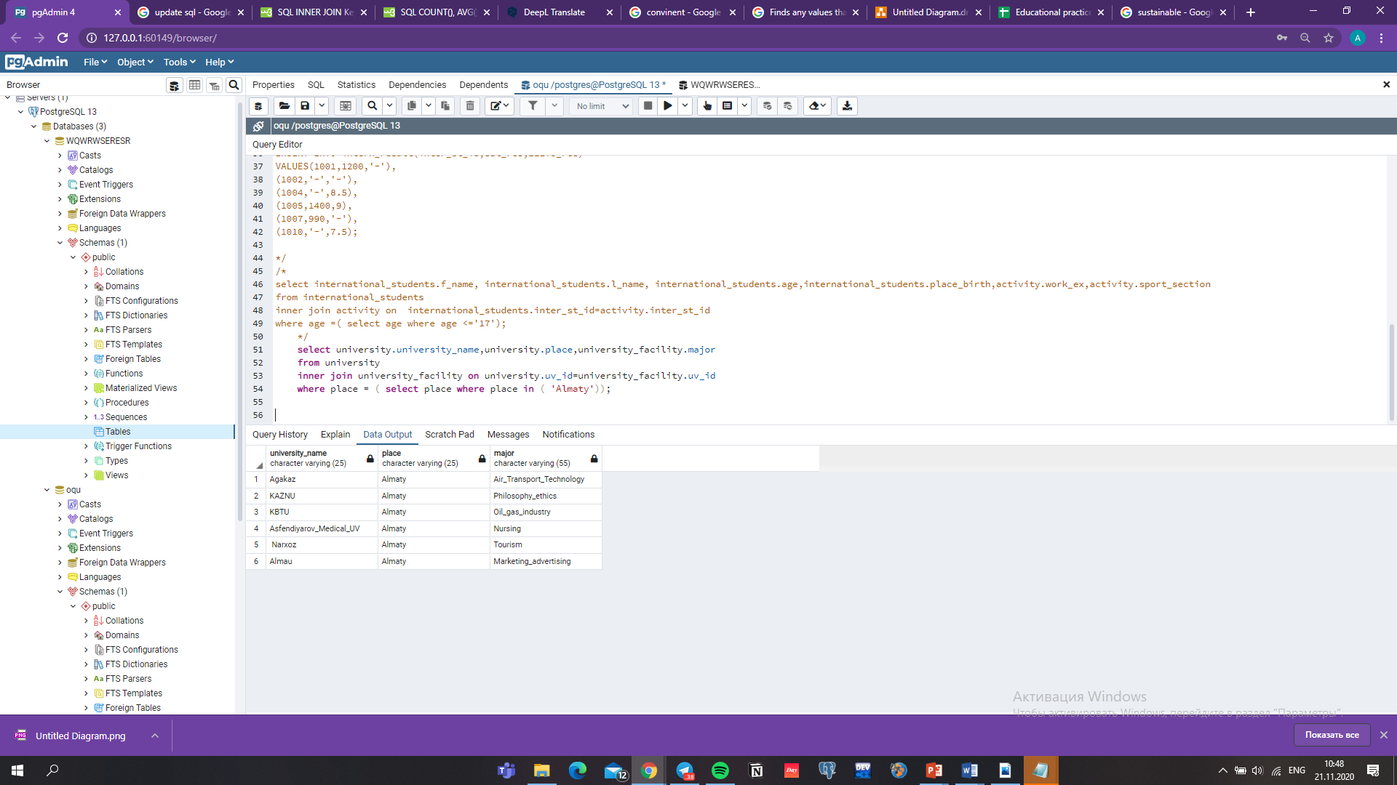

Slide 18
CONCLUSION
OQU must be one of great steps into making application process easier and comfortable to use. Thoughts that OQU database is directed to be main importance for OQU web-platform in near future.
During this project I faced not to many problems, however ICT course lectures were been useful to finish EP class project

Slide 19
REFERENCES
Githinji, N. (2020). Everything you need to know about the Common App. Retrieved 19 November 2020, from https://www.timeshighereducation.com/student/advice/everything-you-need-know-about-common-app
Guides, D. (2020). Study in Kazakhstan. Retrieved 20 November 2020, from https://www.topuniversities.com/where-to-study/kazakhstan/guide
портал, и. (2020). ВУЗы Казахстана, университеты Казахстана. Retrieved 20 November 2020, from http://edu.resurs.kz/univer

